Slide 1
Databricks Clusters, Notebooks and Mounting Data Lake Container to Databricks
Submitted By
Maimoona Khilji

Slide 2
Content
Databricks Clusters
Overview, Cluster types, cluster configuration, cluster creation, cluster pool
Databricks Notebooks
Overview, Notebook introduction, Magic Commands, Databricks Utilities
Mounting Data Lake Container to Databricks
Overview, DBFS, Databricks Mount, Data Lake Storage Gen2,
Azure Service Principal, Mounting Data lake Storage Gen2,
Secret Scope Overview, Creating Secret Scope and Secrets in Key Vault,
Mounting Data Lake Using Secrets

Slide 3
Databricks Clusters

Slide 4
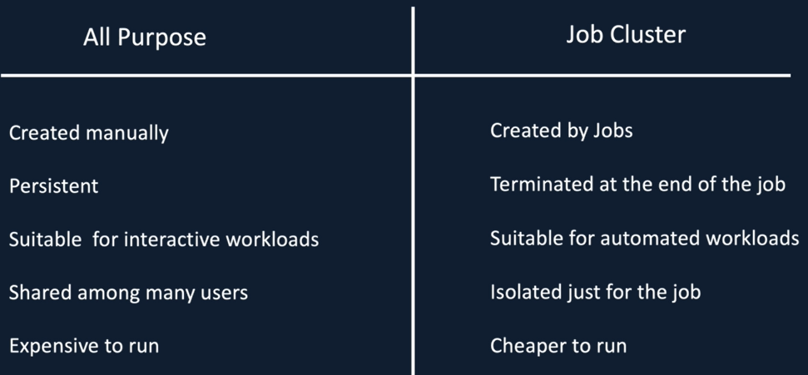
Cluster Types

Slide 5
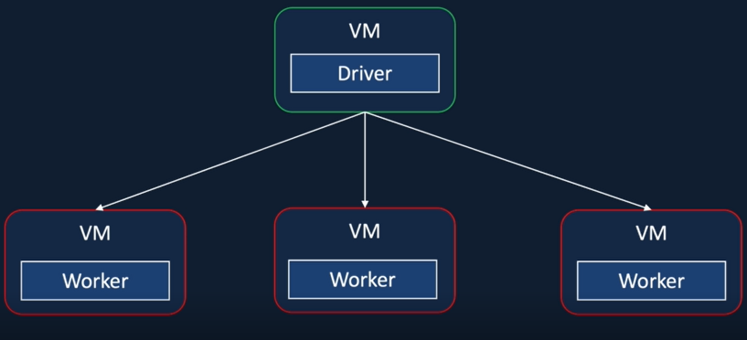
Databricks
Azure Databricks is a data analytics platform optimized for the Microsoft Azure cloud services platform. Azure Databricks offers three environments for developing data intensive applications: Databricks SQL, Databricks Data Science & Engineering, and Databricks Machine Learning. It is a collection of virtual machines.

Slide 6
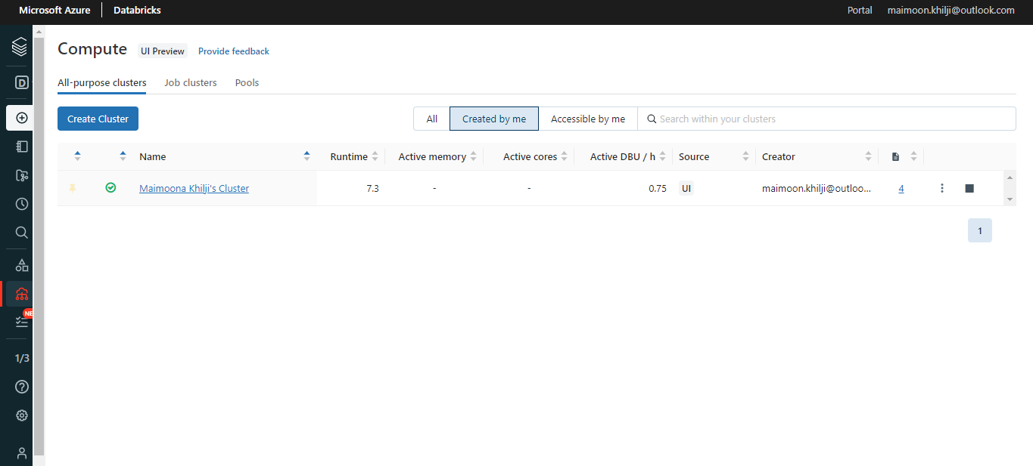
Cluster

Slide 7
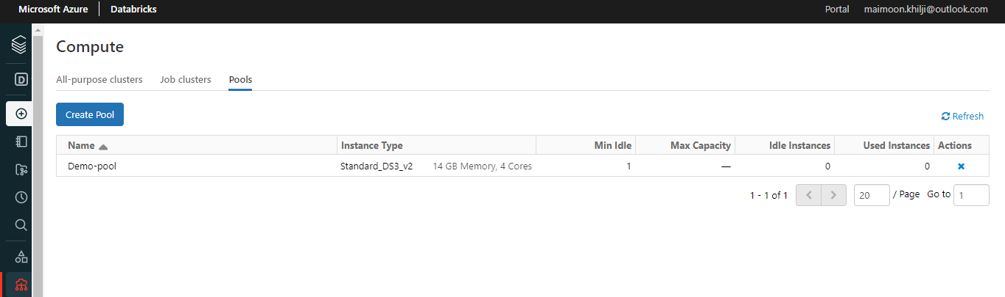
Cluster Pool

Slide 8
Databricks Notebooks

Slide 9
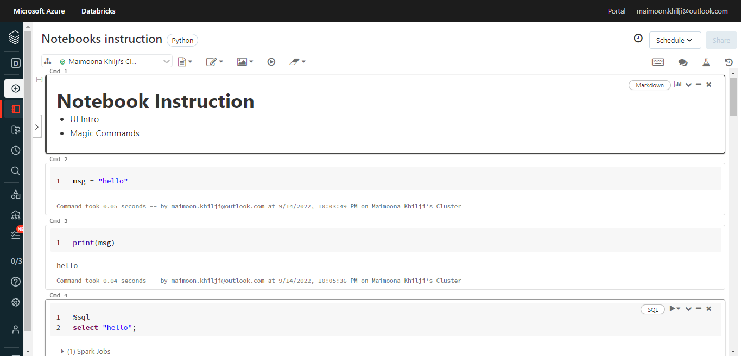
Azure Databricks Notebook and Magic Commands

Slide 10
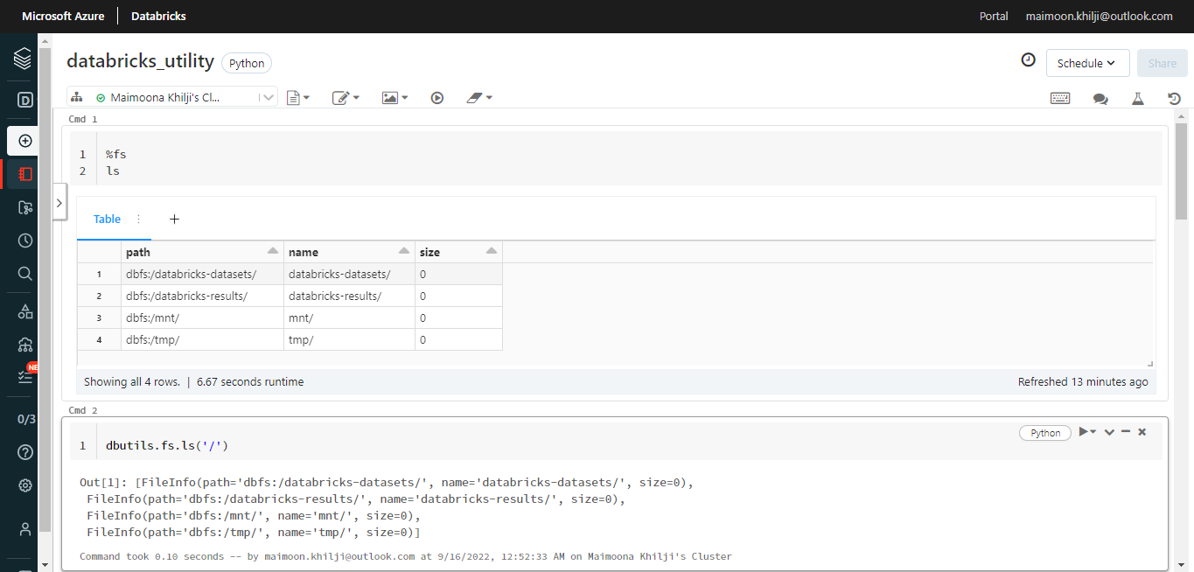
Databricks Utility

Slide 11
Mounting Data Lake Container To Databricks

Slide 12
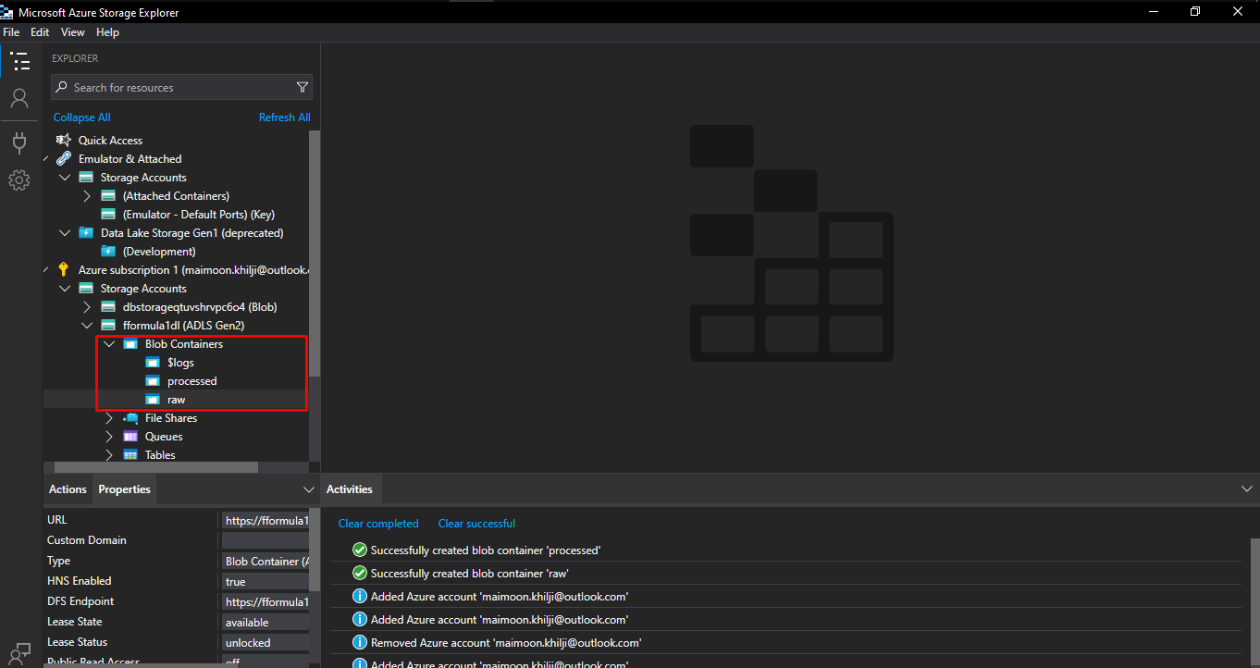
Microsoft Azure Storage Explorer

Slide 13
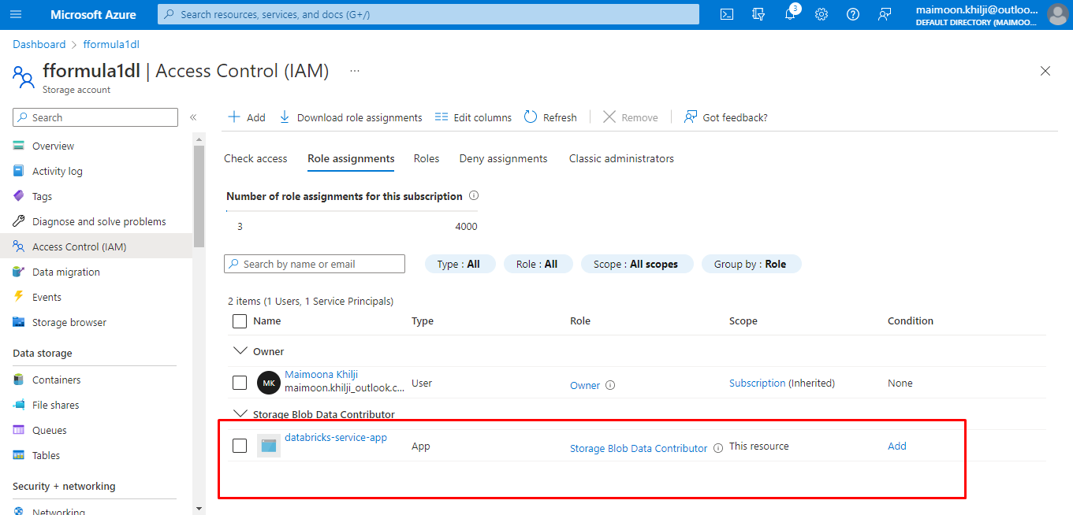
Microsoft Azure - Storage Account - IAM

Slide 14
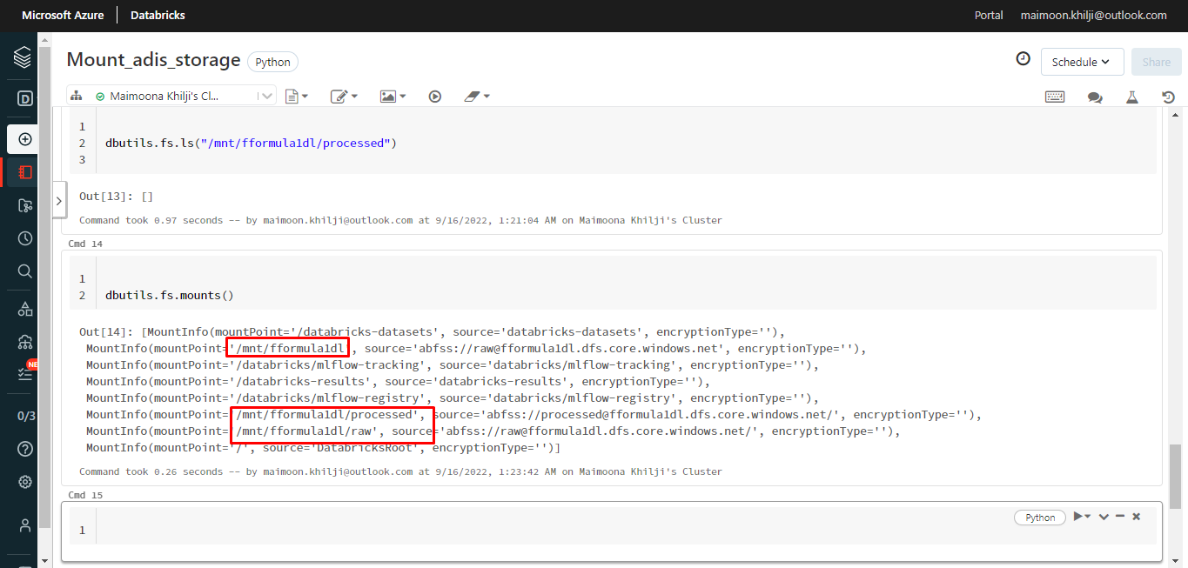
Mounting Azure Data Lake Storage Gen2

Slide 15
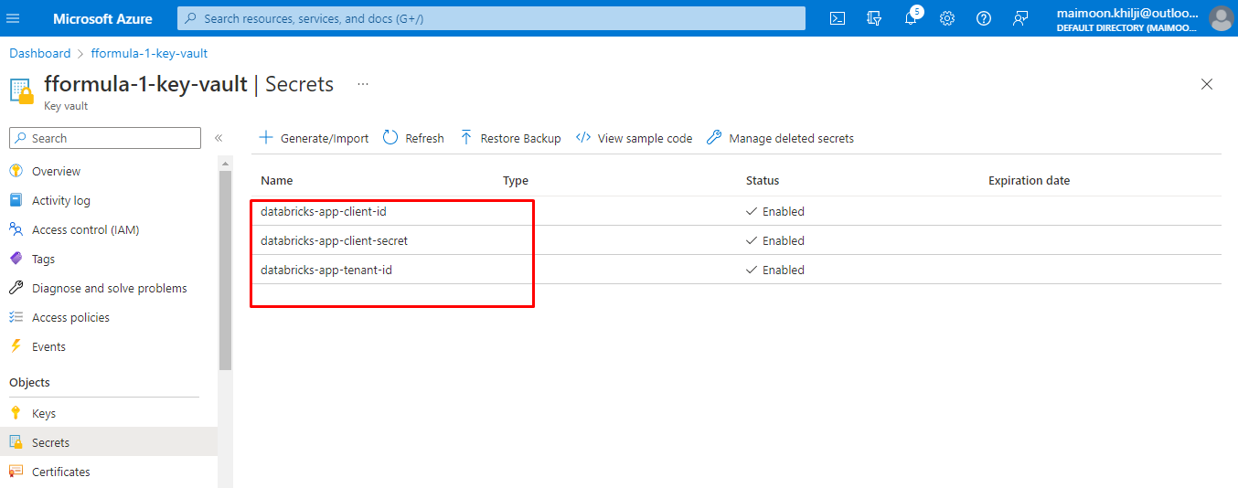
Key-vault Setup

Slide 16
THE END

